Slide 1

Secure programming assitant
Elias Mäkelä

Slide 2
Application functionality
Retrieval augmented chatbot, for the purpose of helping developers create secure applications
Gets context from documents scraped from OWASP to keep up to date with most up to date practices
Managing of previous conversations
Oauth 2.0
Rate limiting

Slide 3
DEMO
Hey, what do you do?
How can I prevent injection attack in SQLite? Give python code example
Give relevant OWASP references so I can get more details

Slide 4
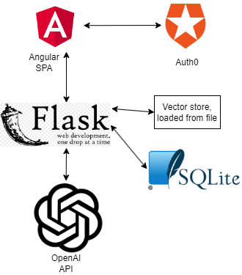
Architecture

Slide 5
Secure programming solution
Follows Oauth2.0 protocol, Auth0 provides features such as brute force protection and monitoring
CORS enforced
API is rate limited
SQL queries are parameterized
User input and LLM output is validated and sanitized
All dependencies checked for vulnerabilites

Slide 6
Testing
API has unit tests implemented with Pytest
Manual testing covered
Authentication, authorization and session management
UI functionality
Error handling
Injection
XSS, CSRF, general input validation
Malicious link generation -> LLM can leak chat history by generating a malicious link

Slide 7
AI tools used in project
GitHub copilot for smart code completion
GPT for
General advice, for example what should be included in the manual testing or for a short explanation of a concept
Debugging

